Slide 1
Reasons for picking the economics metrics as comparison against the stock price and stock trade volume
Stock valuation is highly sensitive to the discount rate.
For example, rising interest rates could lead to :
  Increase the cost of capital
  Reduce the present value of future earnings
  Disproportionately affect growth stocks
Exploratory Analysis
Regression plots (selected economics metrics)
  Change in CPI
  Unemployment Rate
  GDP Growth
  Interest Rate (Fed Rate)
  Inflation Rate
Notes:
Explain data sources.

Slide 2
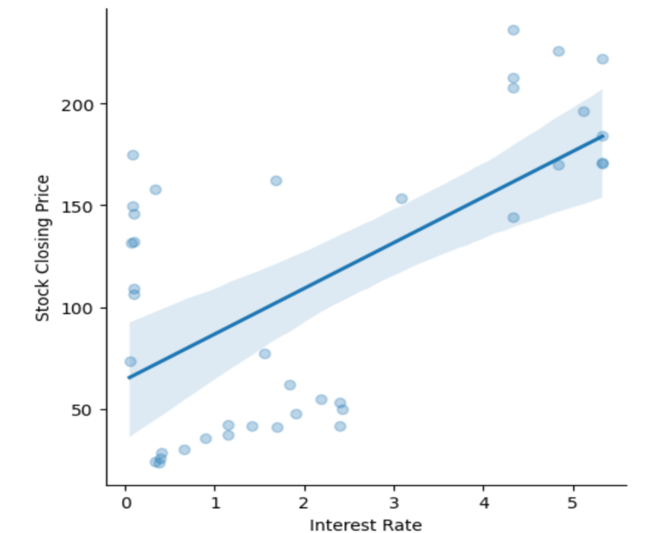
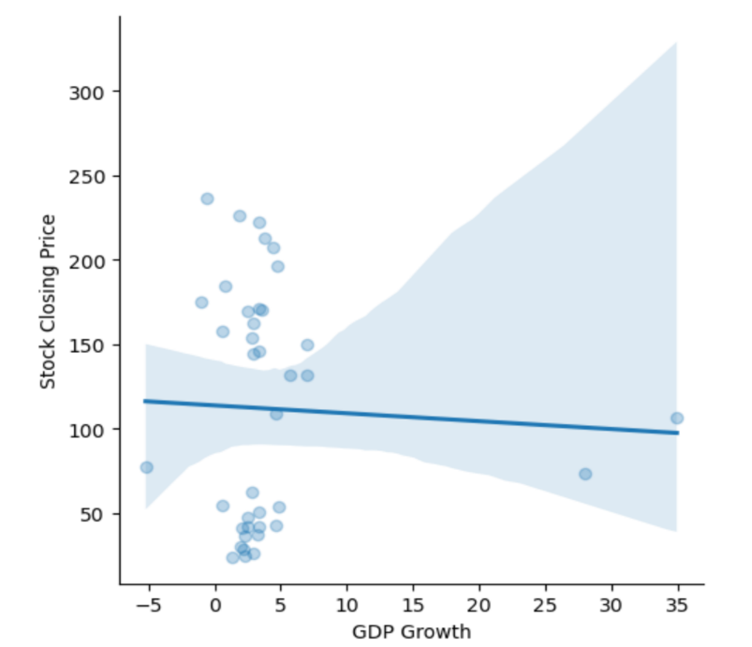
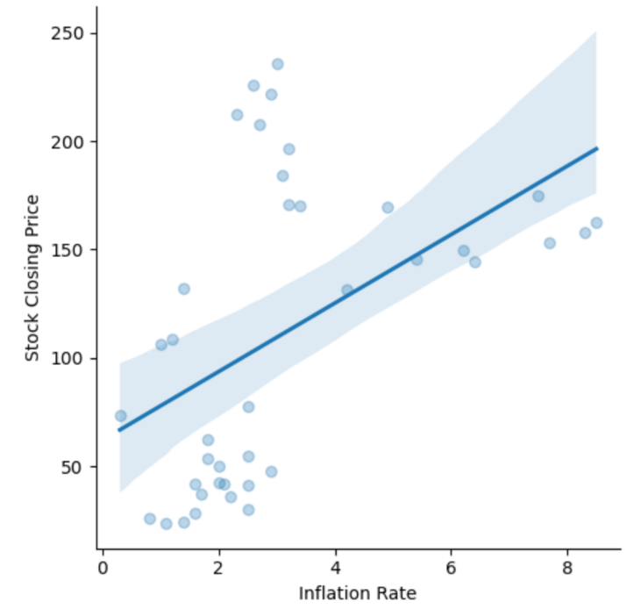
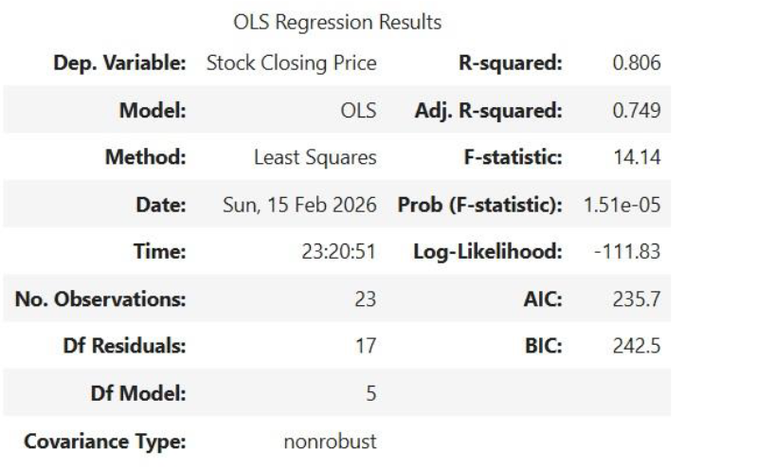
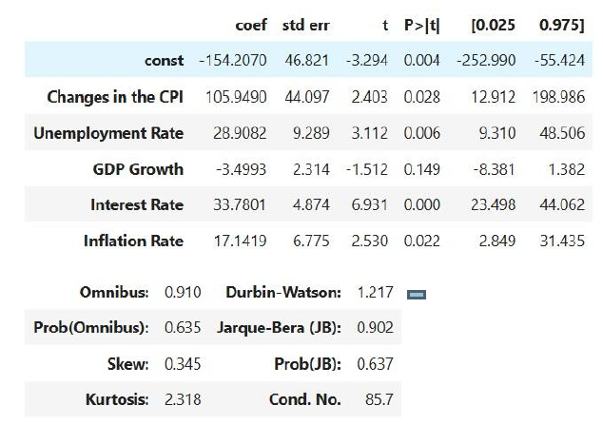
APPL stock closing price against economics metrics
Based on OLS regression result –
  R Squared is 0.806, indicate 80.6% of the variance of the stock closing price is explained by the independent variable in the model
  GDP Growth is not statistically significant.
  Interest Rate, Inflation Rate and Unemployment Rate are positive and significant.
Notes:
Explain data sources.

Slide 3
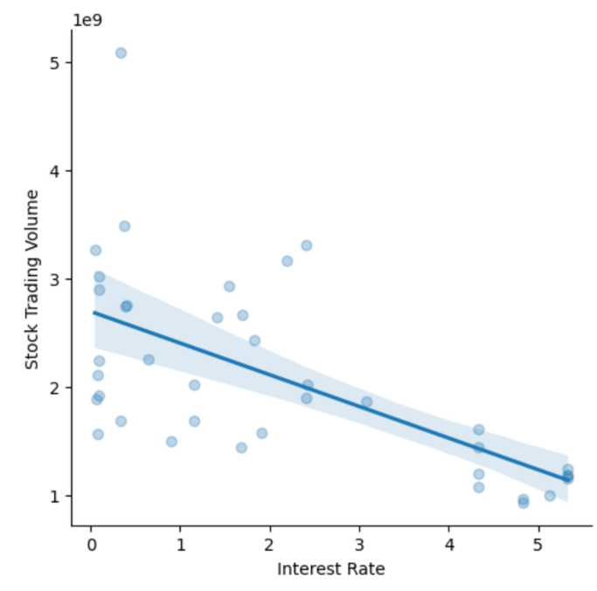
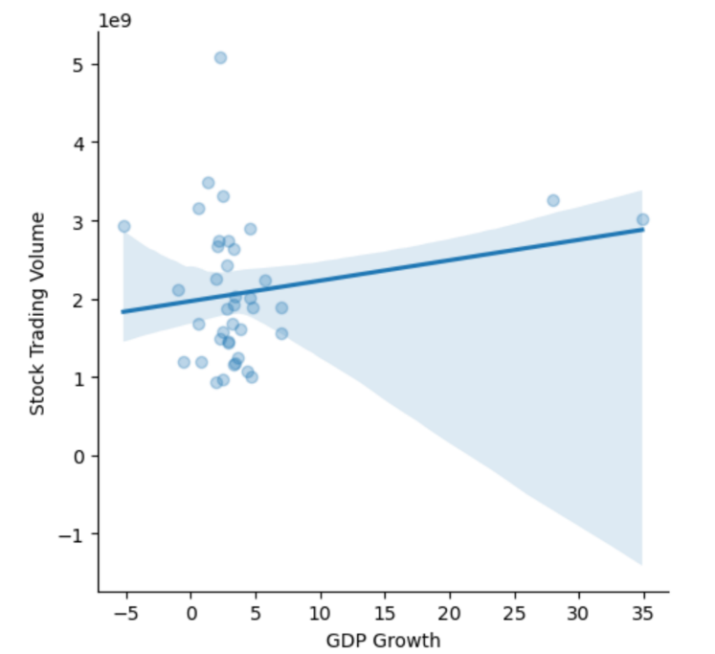
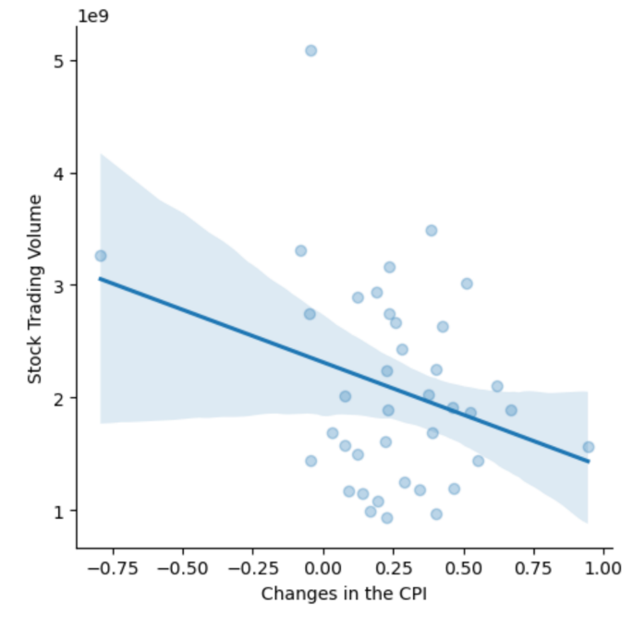
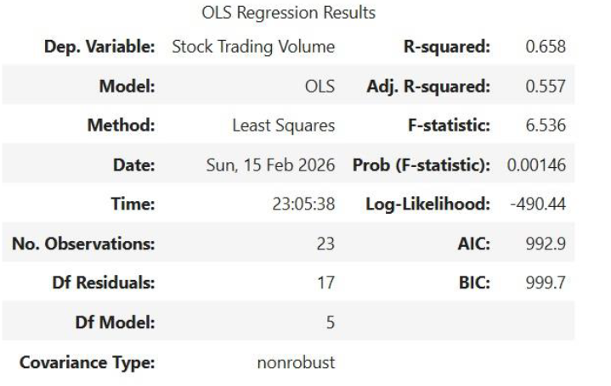
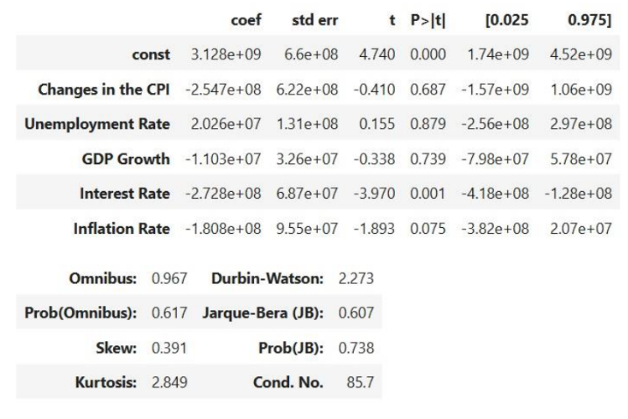
APPL stock trade volume against economics metrics
Based on OLS regression result –
  R Squared is 0.658, indicate 65.8% of the variance of the stock trading volume is explained by the independent variable in the model.
  Interest Rate is highly significant. Model is primary driven by this rate.
  Change in CPI, GDP Growth and Unemployment Rate are not significant.

Slide 4
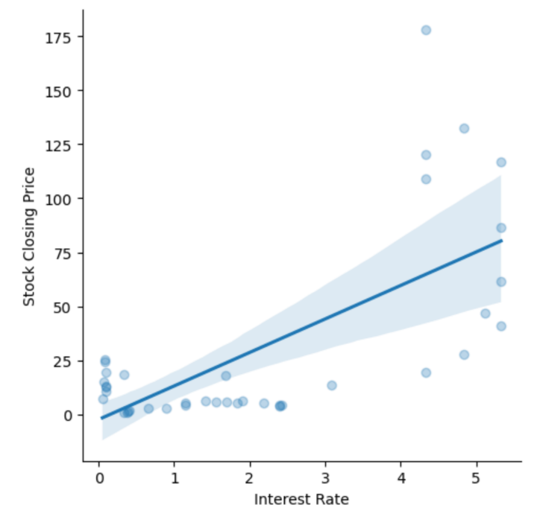
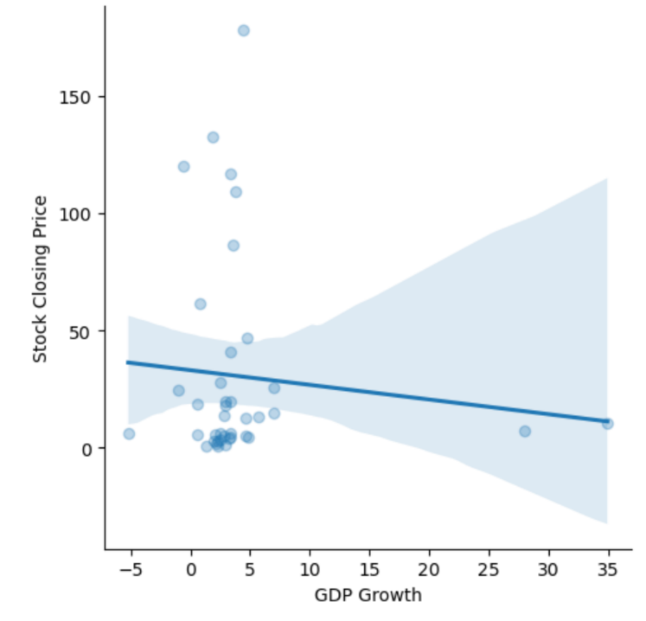
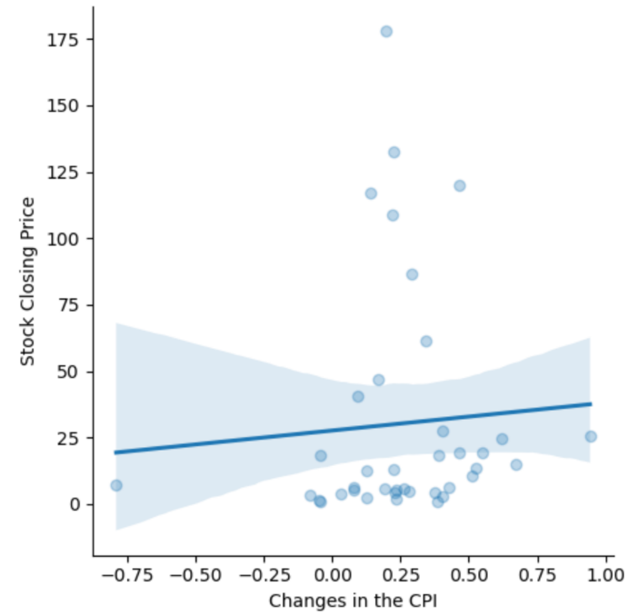
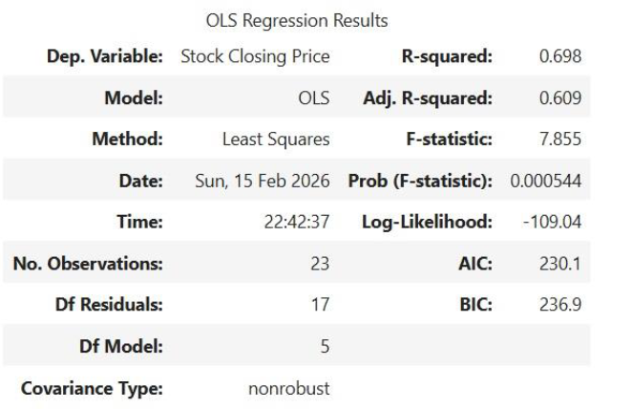
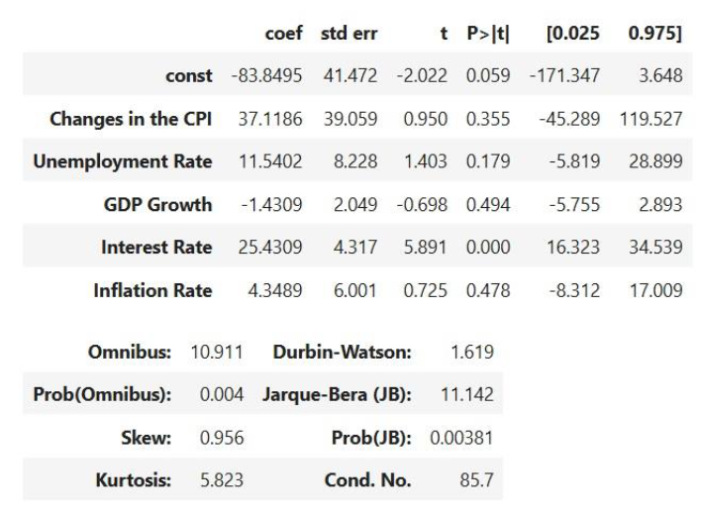
NVDS stock closing price against economics metrics
Based on OLS regression result –
  R Squared is 0.698, indicate 69.8% of the variance of the stock closing price is explained by the independent variable in the model
  Interest Rate is highly significant.
  Inflation Rate, Change in CPI, GDP Growth and Unemployment Rate are not significant.
Notes:
Explain data sources.

Slide 5
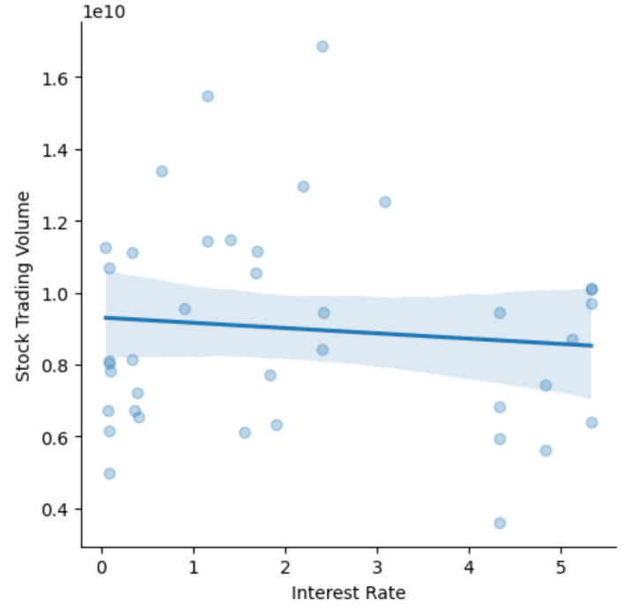
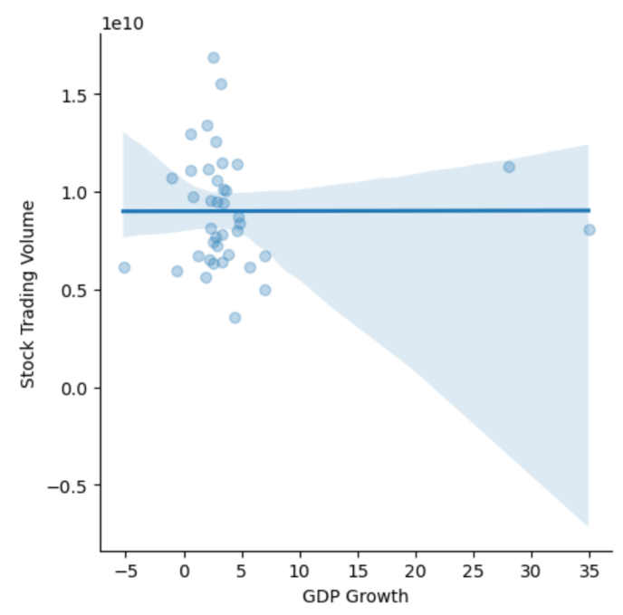
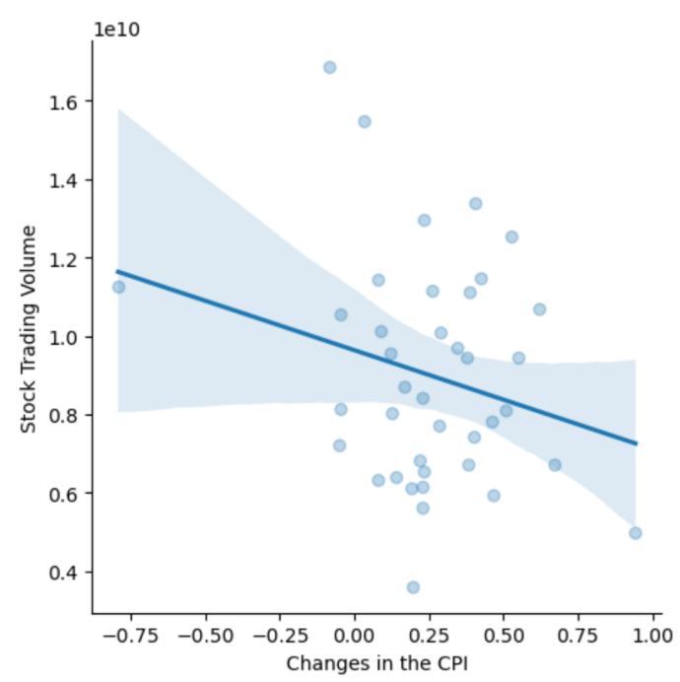
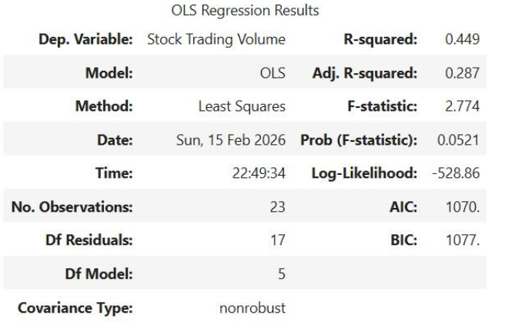
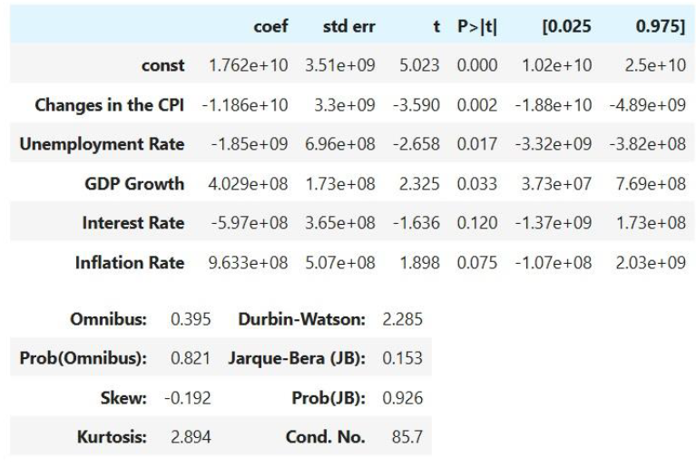
NVDS stock trade volume against economics metrics
Based on OLS regression result –
  R Squared is 0.449, indicate 44.9% of the variance of the stock trading volume is explained by the independent variable in the model
  Change in CPI, Unemployment Rate and GDP Growth are highly significant and drivers of trading volume.
  Inflation Rate is marginally significant and Interest Rate is not significant.

Slide 6
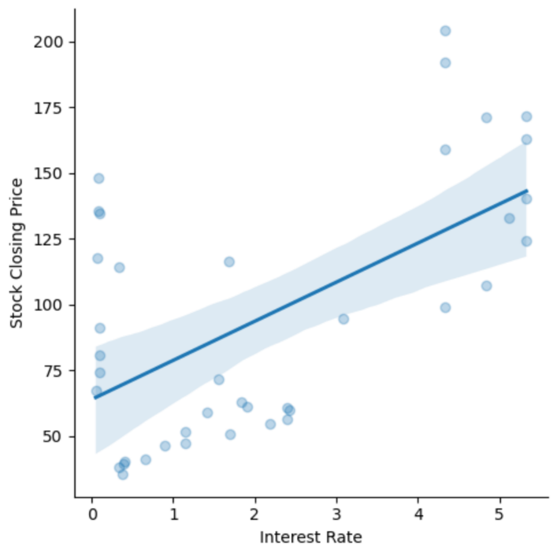
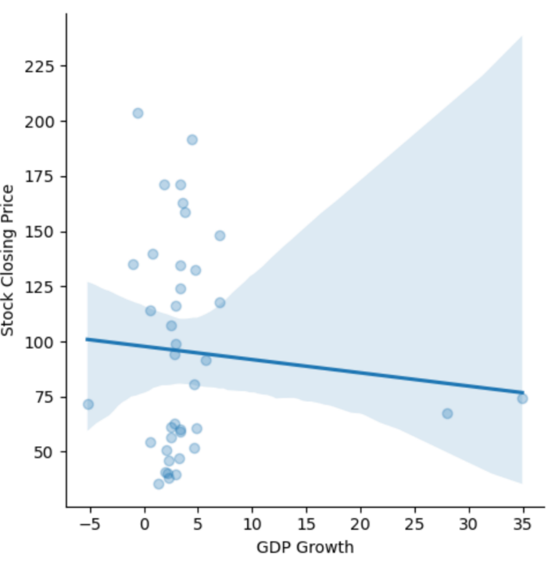
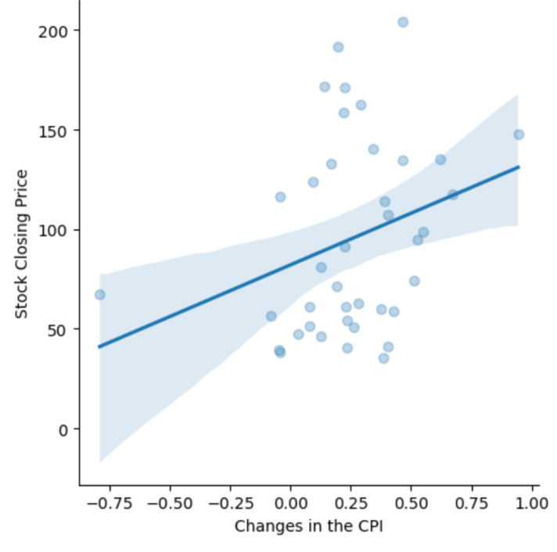
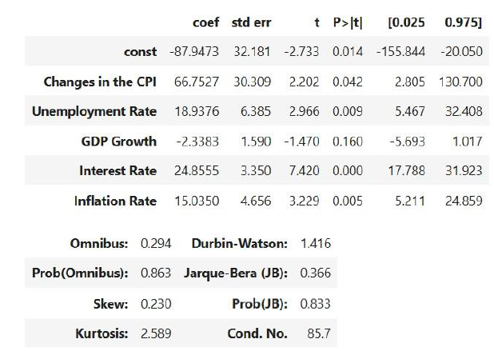
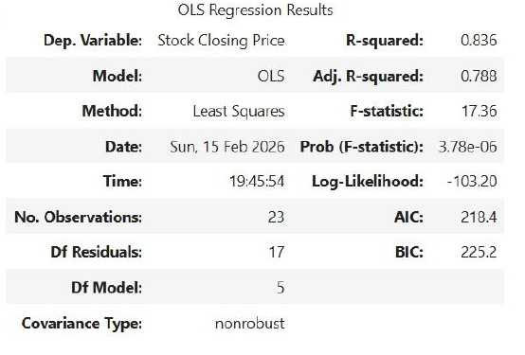
GOOGL stock closing price against economics metrics
Based on OLS regression result –
  R Squared is 0.836, indicate 83.6% of the variance of the stock closing price is explained by the independent variable in the model
  Interest Rate, Inflation Rate, Unemployment Rate and Changes in CPI are highly significant.
  GDP Growth is not significant.
  Primary driven by Interest Rate and Inflation.
Notes:
Explain data sources.

Slide 7
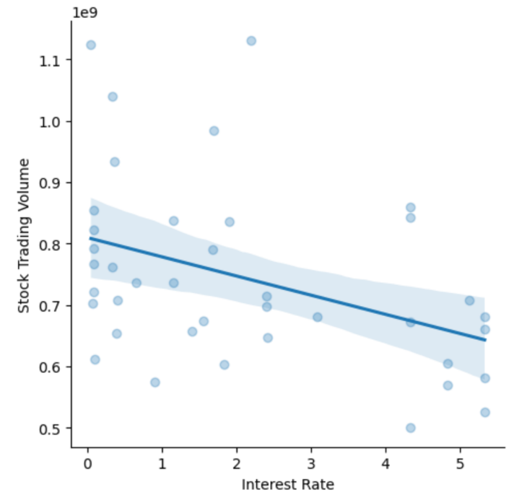
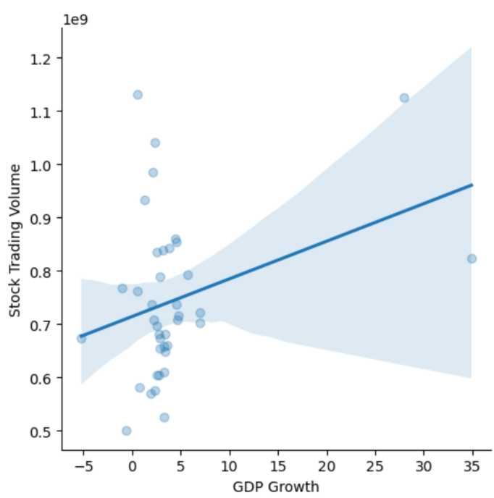
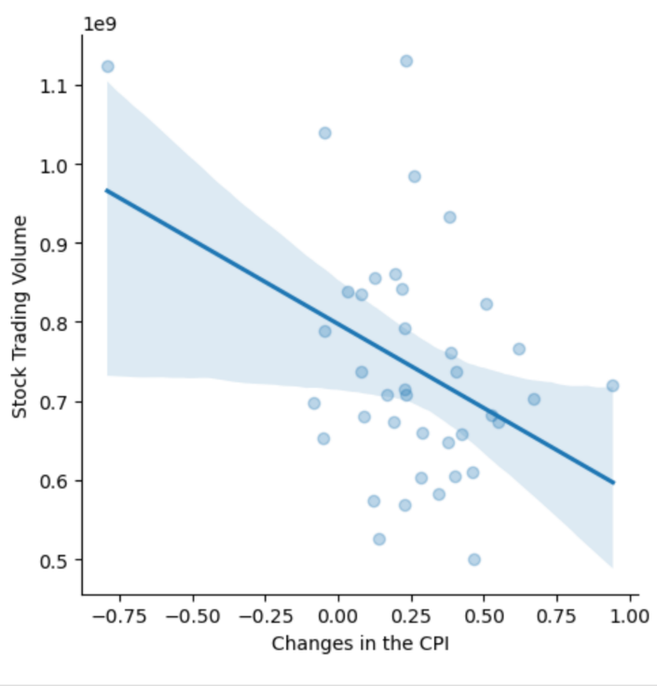
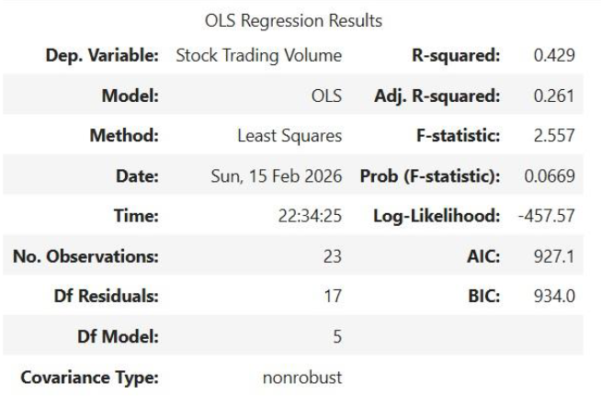
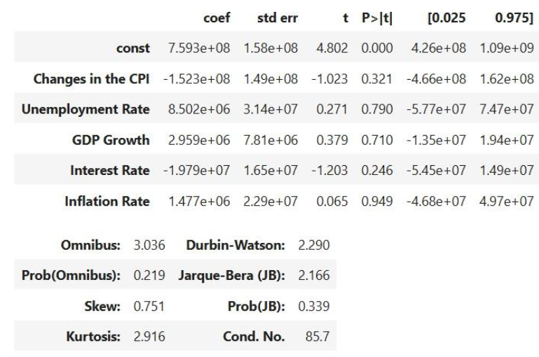
GOOGL stock trade volume against economics metrics
Based on OLS regression result –
  R Squared is 0.429, indicate 42.9% of the variance of the stock trading volume is explained by the independent variable in the model
  Change in CPI, Unemployment Rate, GDP Growth, Inflation Rate and Interest Rate are all not significant.
  The model struggle to find a significant relationship.

